Slide 1
Headline Contents Classification - NLP
Presented by YAO

Slide 2
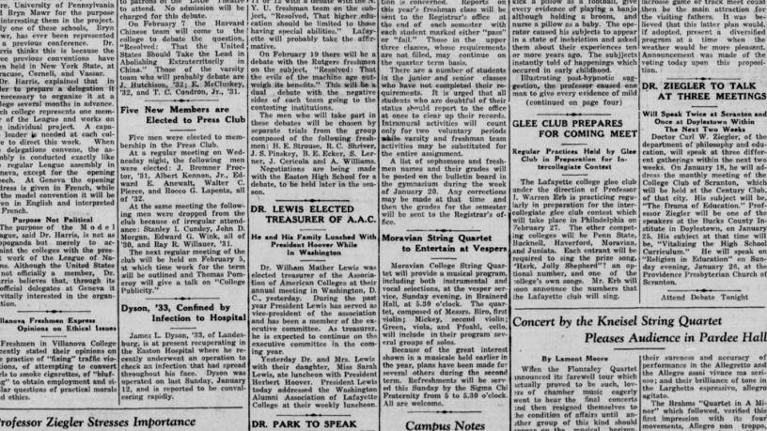

Slide 3
OBJECTIVES
Build a classification model to identify categories of news
Using Various Techniques
Model’s Performances comparison
Future challenges : deploy the model to cloud (heroku,aws,azure), recommend an/some article(s)
https://www.kaggle.com/uciml/news-aggregator-dataset
Sentimental Classification of News Headlines using Recurrent Neural Network
S. Prakashini, D. Vijayakumar
Real Time News Headlines Classification Using Machine Learning
Manvendra Singh Chhajerh1, Ananya KVS2, Prof. Merin Meleet3, Dr. Rajashekara Murthy

Slide 4
1 - DATASET EXPLORATION
Features:
Id: numeric ID, unique ID of a given headline
Title: news title
Url: full link address to the article
Publisher: publisher name
Story: alphanumeric ID of the cluster that includes news about the same story
Hostname: Url hostname
Timestamp: approximate time the news was published, as the number of milliseconds
Category: Category of a given article, Below a list of them
Entertainment, business, science and technology, health, Us magazine, GossipCop, CBSnews, Reality TV World, The Hollywood
Entertainment
Business
science and technology
health
Shape:
Rows : 400k samples
Columns: 8

Slide 5
PATH
Read,Drop null, Split Text into Words
Convert into arraylist(token)
Remove numbers, stopwords, special Characters,
Assessing NB and model Comparison
Create Index of Categories
Build models

Slide 6
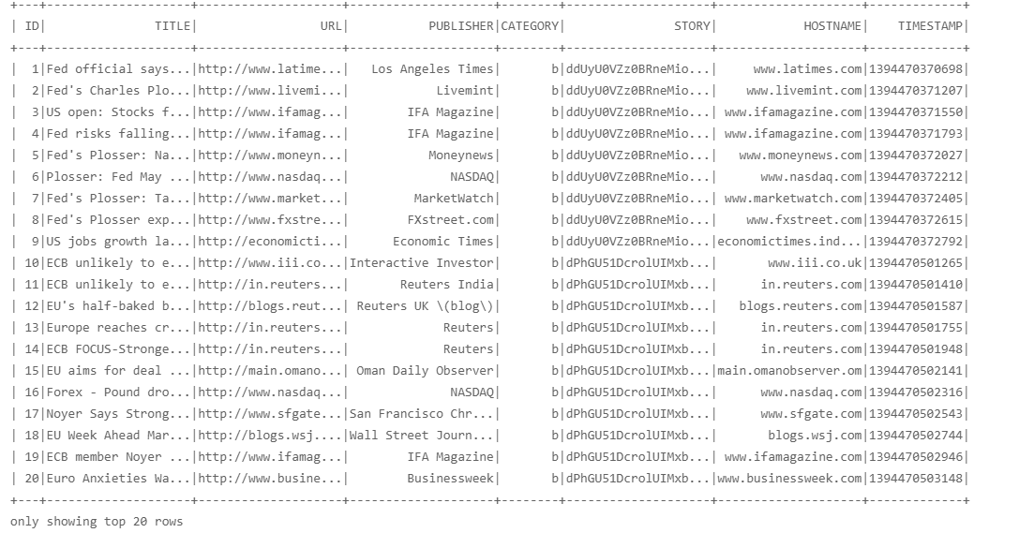
Dataset -Read,Drop null, Split Text into Words
Null values Title
389
Null values Category
516

Slide 7
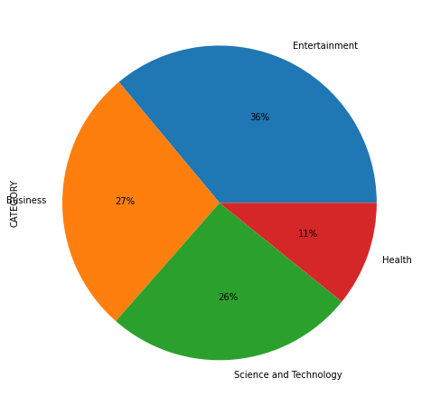
Pie chart - Categories of headlines represented
Most represented types of headlines Entertainment
Followed by Business and Science & Technology
Health topic is last topic to be visited

Slide 8
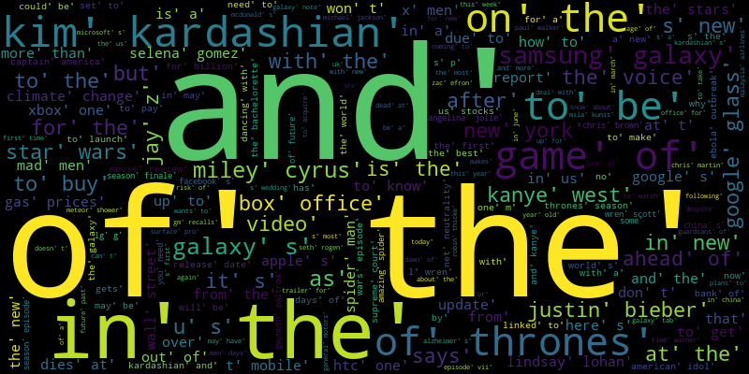
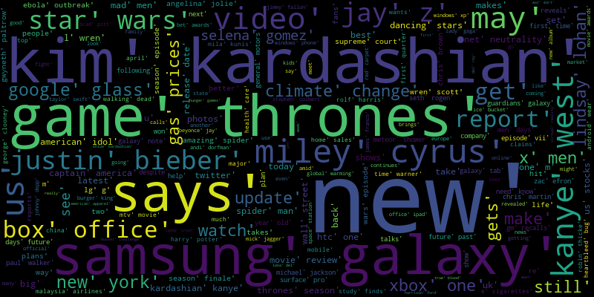
Convert into arraylist(token), Remove numbers, stopwords, special Characters
Notes:
RegexReplace
RegexTokenizer().transform() : convert into arraylist
StopWordsRemover().transform()

Slide 9
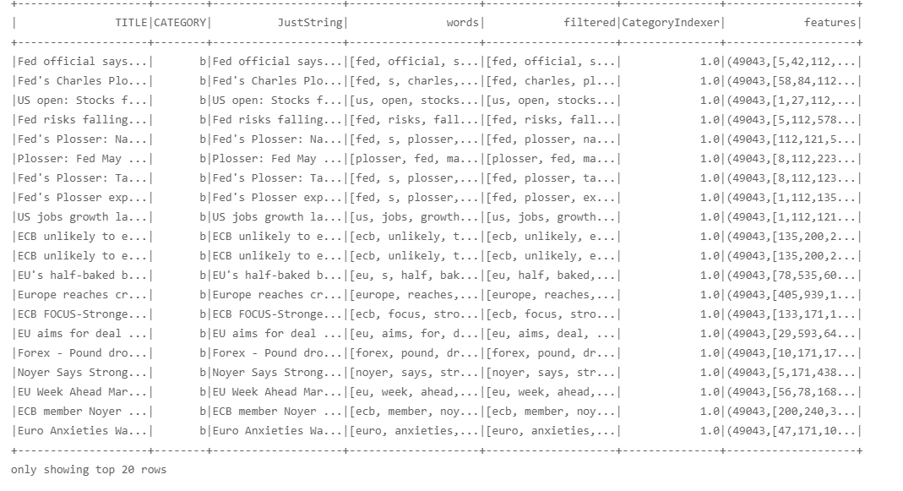
Create index of categories and vector of token counts

Slide 10
Build Models and Compare - 7 Columns each
Training set = 80% 337 669 rows Test set = 20% 84752 rows
Learning Algorithm | Accuracy of | Ngram | Stopwords | tf-idf
Logistic Regression | 0.94% | Default (1,1) | Used a function based on regex | False CountVectorizer()
Naive Bayes | accuracy of NB : 0.92 test error : 0.074 | Default (1,1) | RegexTokenizer,StopWordsRemover | CountVectorizer()

Slide 11
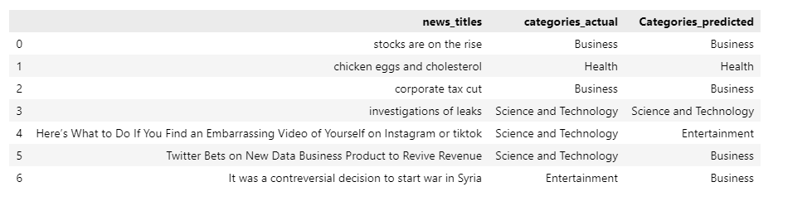
Prediction Based on input

Slide 12
Future Challenges
Future challenges : deploy the model to cloud (heroku,aws,azure) So that the user can have interaction with the system, recommend an/some article(s)
https://germannewsclassifier.herokuapp.com/ (Realtime classifier) and Real Time News Headlines Classification Using Machine Learning and Manvendra Singh Chhajerh1, Ananya KVS2, Prof. Merin Meleet3, Dr. Rajashekara Murthy
https://github.com/iyfyao/

